Slide 1
The Bureau of Economic Analysis’s State-level Public Pension Estimates
BEA Advisory Committee Meeting
Washington, DC
November 15, 2019
Don Boyd, Co-Director
State and Local Government Finance Project, Center for Policy Research

Slide 2
Important benefits of BEA state-level defined benefit public pension estimates for public pension analysis
Comprehensive (all plans, estimated)
50 states + DC
Time series (2000+, annual)
Market-based discount rate
Same discount rate, all plans
Assets on market-value basis
Includes estimates of normal cost, and data on actual contributions
Quality control
These characteristics in combination allow state-level analysis (with caution) of liabilities and costs, and comparisons to contributions, on a reasonably consistent basis over time and across states. No other data source allows this (absent enormous work).
The data also allow detective work for individual states.

Slide 3
Selected compilations of public DB pension data
 | BEA | Public Plans Database (PPD) (Boston College...)* | Moody’s adjusted net pension liabilities*
Reported at: | State geography | Primarily plan-level | Primarily state-level totals for state plans, local plans
Universe | Complete -- estimated | ~190 plans ~90% of assets | 227 large SG plans; 50 large locals
Availability | Annual (CY), 2000-2018 | Annual (FY), 2001-2018 | Annual (FY), ~2011-2018
Discounting | Based on Moody’s AAA corporate; 4% for 2018 | Plan-chosen rates; 7.3% median for 2018 | High-quality long-term taxable (FTSE PLI); ~4.1% 2018
MV assets Liability Unfunded; FR Employer NC Payroll; NC % | $4.1 trillion $8.6 trillion $4.5 trillion; 47.3% $167 billion $928 b; ~17% (Boyd ests.) | $3.7 trillion $5.2 trillion $1.5 trillion; 71.8% $52 billion (noisy) $733 billion; 7.1% (noisy) | ~$1.6 tr states, $0.5 tr local
Other | Lumpy DR changes | Limited resources for QC | Paywall + inconvenient
* These are the most prominent producers/providers/publishers of these data. There are some alternatives.
Notes:
Notice the big difference in employer normal cost.

Slide 4
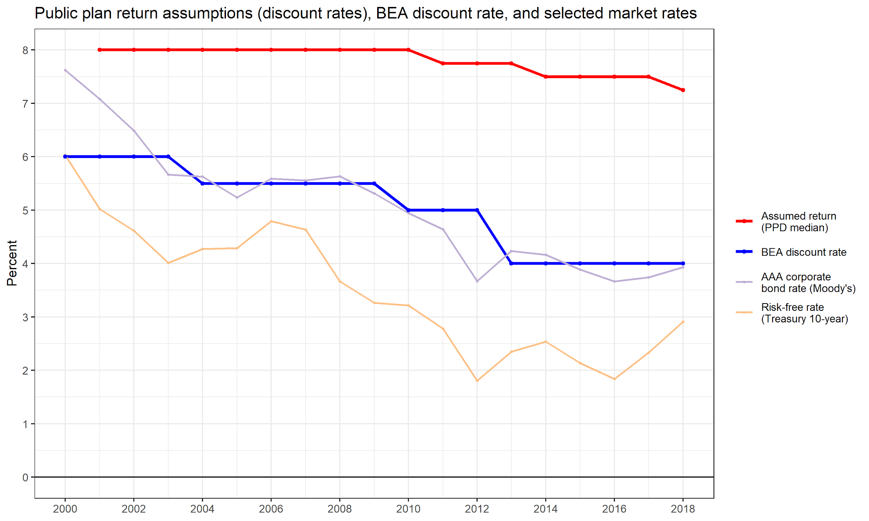

Slide 5
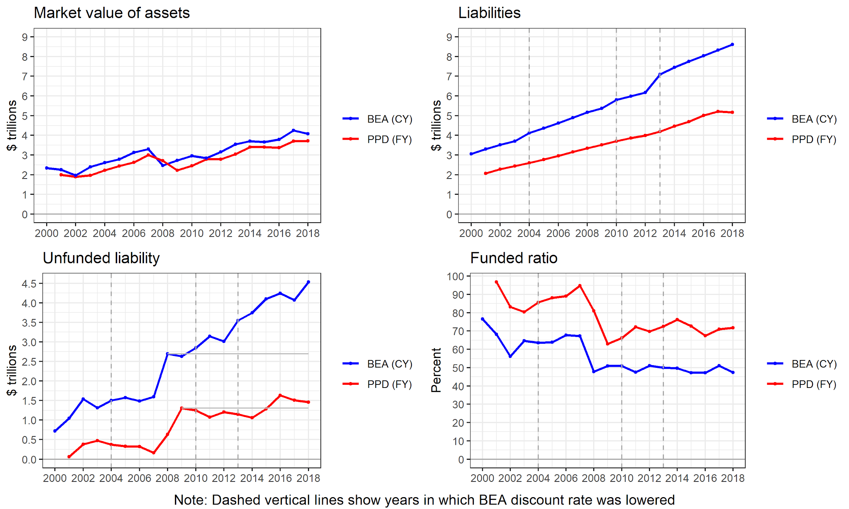

Slide 6
Other data sources do not allow aggregation of plans, and comparison to economic and tax base that must fund them
For example, Illinois taxpayers (largely) must pay for multiple underfunded plans:
Illinois Teachers’ Retirement System
State Employees’ Retirement System
State Universities Retirement System
Chicago-area funds: Municipal Employees, Laborers’, Police, Firemen’s; Chicago Public Schools; Cook County Employees’; Chicago Transit Authority
Many lesser funds in the Chicago area and throughout the state, most of which are deeply underfunded
BEA data allow this. It is a valuable way to compare across states.
(It would be nice - but much harder still - to do this for smaller geographic areas.)

Slide 7
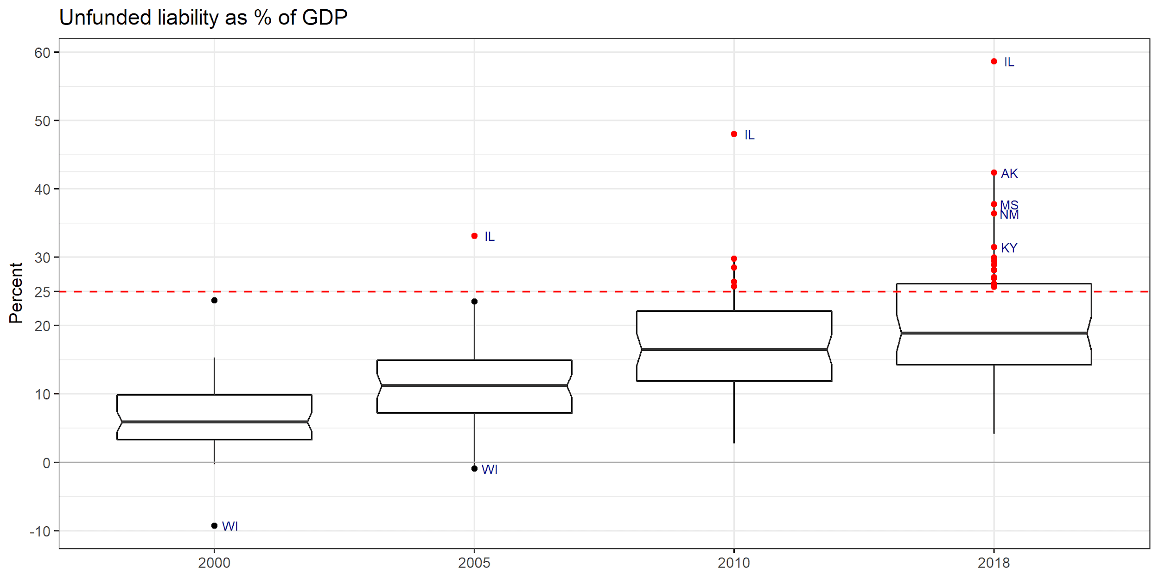
There’s no place like Illinois

Slide 8
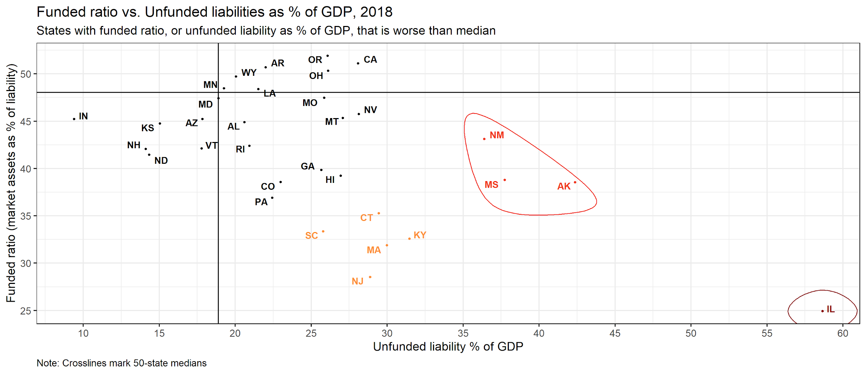
Ability to aggregate, and to examine unfunded liabilities as % of GDP, reveals pressure that funded ratio alone does not

Slide 9
BEA data allow comparison of employer normal cost, potential additional costs, and actual contributions on ⋍ consistent basis
Employer normal costs (ENC) differ across plans due to varying earnings assumptions (among other reasons). Only partially available in compiled sources (PPD) and in idiosyncratic forms in plan source documents (CAFRs, valuations).
Interest & amortization amounts differ across plans due to varying earnings assumptions, funding methods, other factors. Same availability issues as ENCs.
BEA data provide or allow:
ENC on consistent discount-rate basis. Comparison to actual employer contribution (AEC)
Imputed interest on unfunded liability: {(ENC + interest) == AEC} → treading water.
Estimation of amortization of unfunded liability under consistent method.
Comparison of ENC, “treading water” contributions, and amortizing contributions, on a “secure funding” (low rate) basis, to actual contributions.

Slide 10
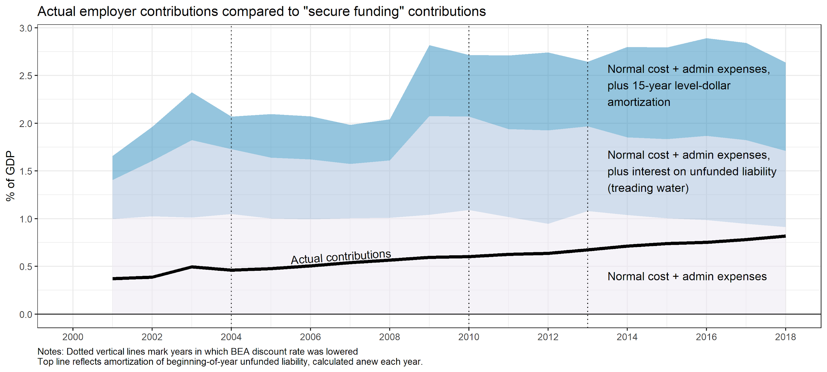
BEA data allow us to compute gap between actual employer contributions and “secure funding”
Treadwater
gap

Slide 11
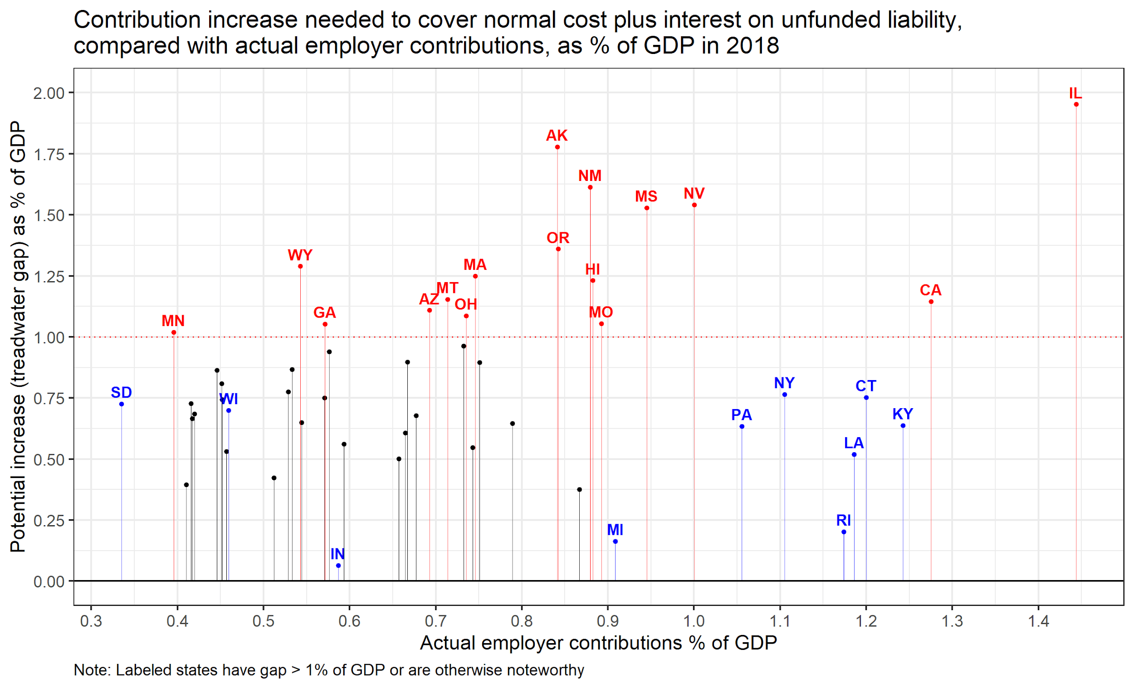
Treadwater gaps in 2018
1% of GDP for US is roughly equivalent to:
49% of all state-local income or sales taxes, or
29% of all K12 spending, or
190% of all highway capital spending

Slide 12
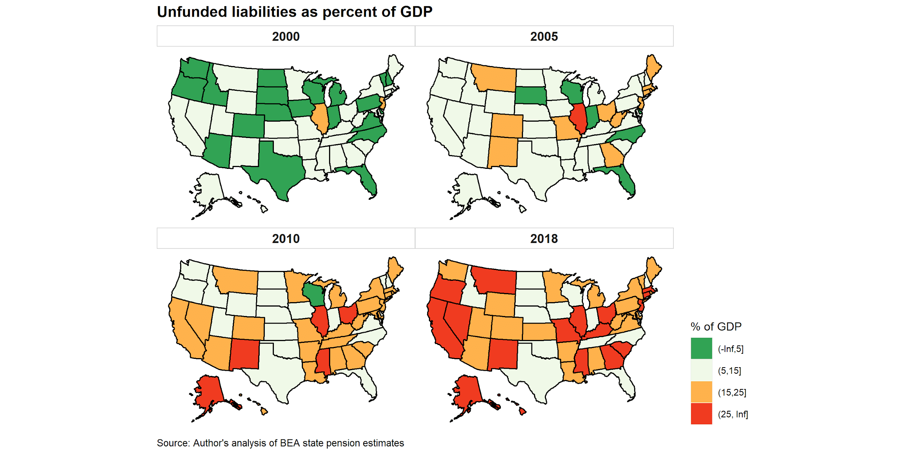
Unfunded liabilities have grown in most states

Slide 13
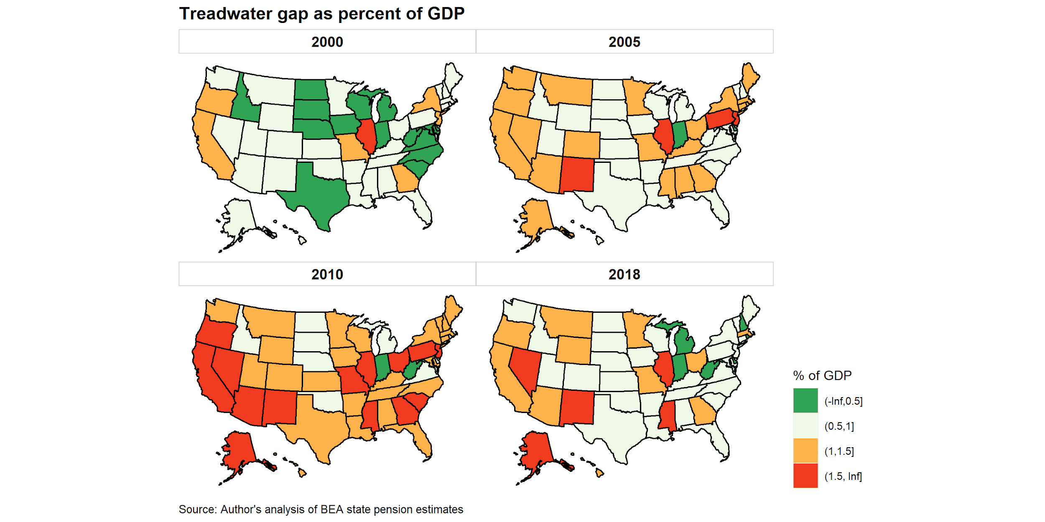
But contribution increase needed to “tread water” has fallen recently (due to contribution increases and benefit cuts)

Slide 14
Detective work on Rhode Island pension reforms/cuts
Rhode Island enacted widely publicized pension reforms (benefit cuts) in the 2011 RI Retirement Income Security Act (RIRSA), including COLA suspension. Affected current workers and even retirees, in 2012 and beyond.
Perhaps that is why the “Treadwater gaps in 2018” slide shows a very low gap for RI (and high contributions)?
It’s complicated:
RI long had much worse underfunding than other states
The General Assembly adopted major benefit cuts before RIRSA
2005 substantial cuts, but mostly affecting new and recent hires
2009 major cuts, more retroactive
The 2011 reforms were challenged and modified in a 2015 settlement agreement
RI lowered its earnings assumption from 8.25% to 7.5% in its 2010 valuation. Other changes.
RI moved to a hybrid DB-DC plan. We only have data here for the DB plans.
Can BEA data help us understand what happened? Let’s break it down.

Slide 15
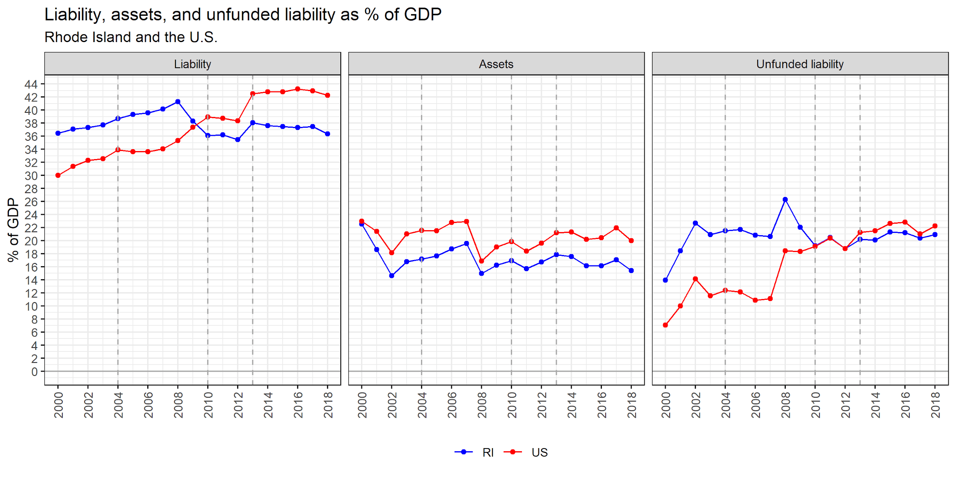
RI total liability decline from 2008 to 2010 drove the decline in unfunded liability, largely before the 2011 reforms took effect
Notes:
These declines preceded the widely discussed reforms.

Slide 16
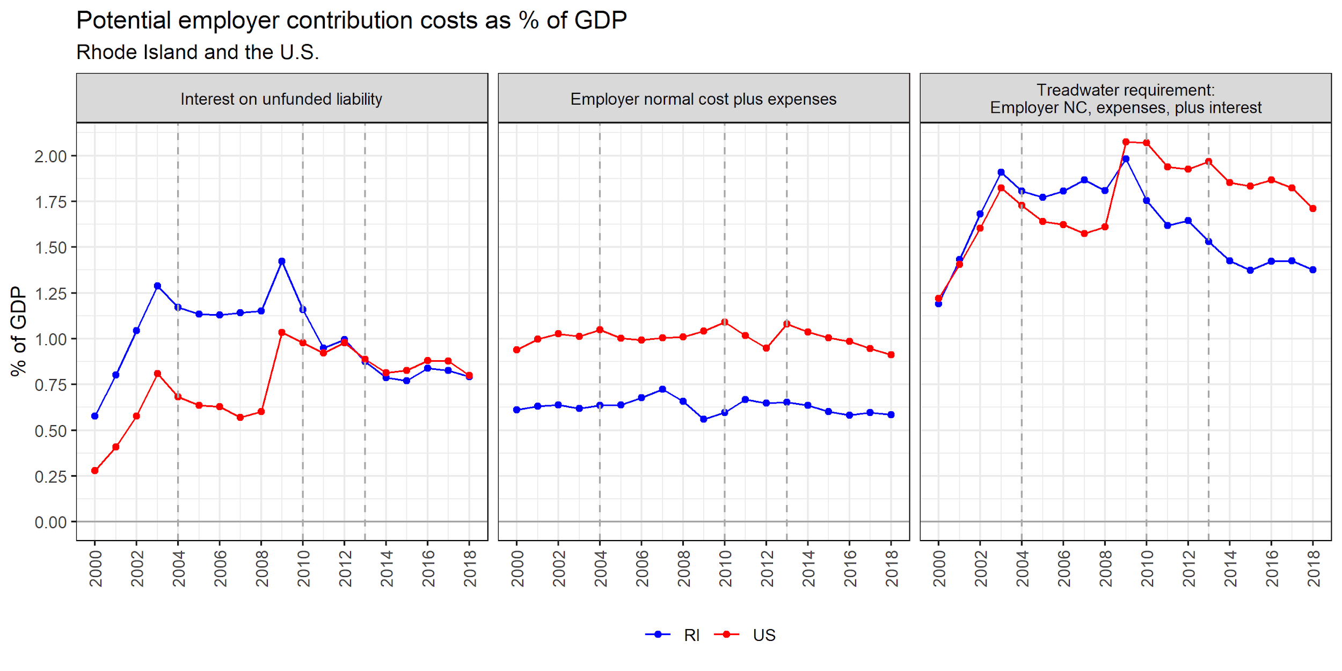
Decline in unfunded liability drove down imputed interest cost needed to “tread water”; normal cost changes appear smaller
Note: BEA discount rate reductions increase unfunded liability but lower interest cost for a given unfunded liability. Net impact should be small.

Slide 17
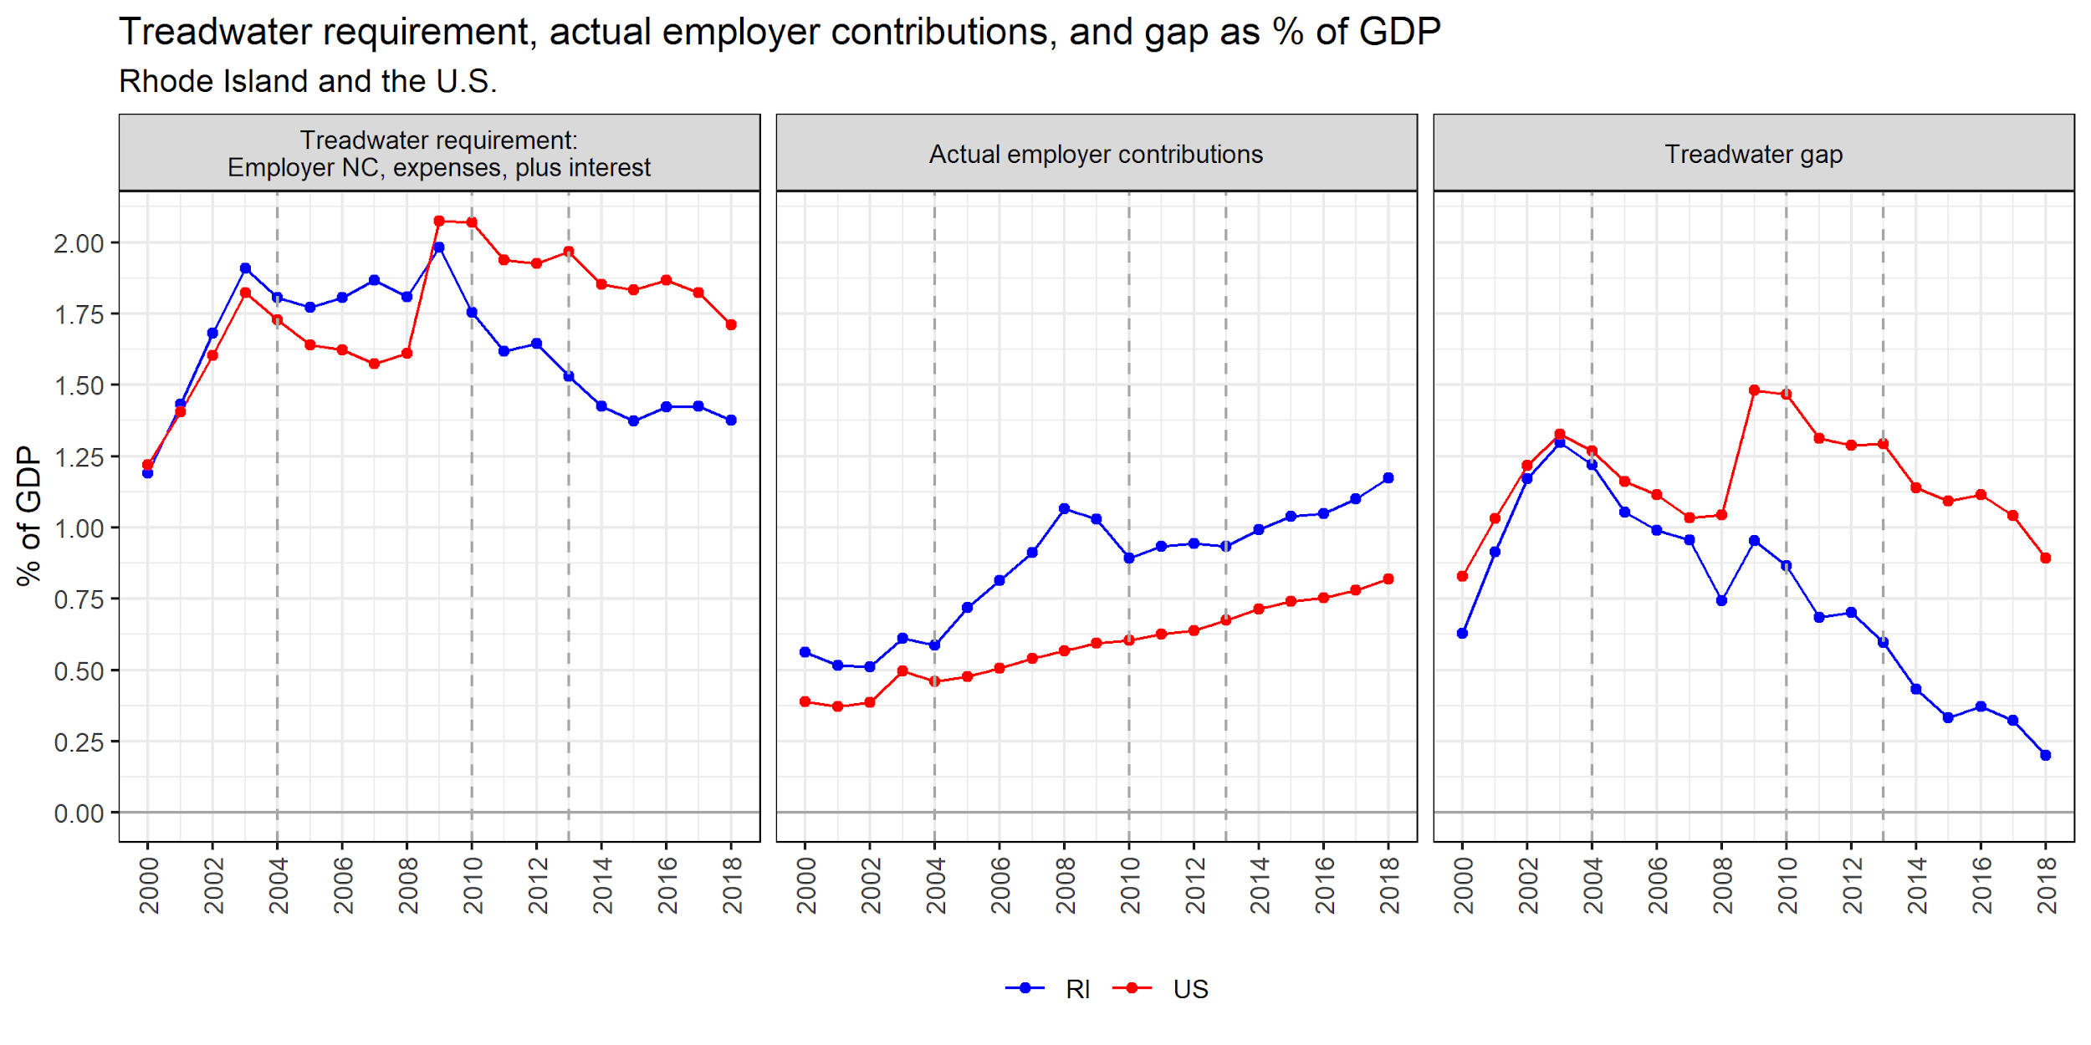
Decline in contributions needed to tread water, plus employer contribution increases, dramatically reduced RI’s “treadwater gap”
Notes:
These declines preceded the widely discussed reforms.

Slide 18
Detective work was moderately successful
BEA data suggest that greatest impacts came from reforms that preceded the highly publicized 2011 reforms (which affected 2012+).
Impact on potential costs came primarily through reductions in liability and resulting lower imputed interest on unfunded liability. Reductions in normal cost appear small.
Generally can’t reduce liability without a crisis political environment and permissive legal environment.
My selective checks against CAFRs and other summary data suggest the BEA data are more representative of what happened than seemingly conflicting other data.
Still, the conclusion that so much of this happened before the 2011 reforms is surprising to me (perhaps not to RI experts), and is a tentative conclusion.
As with much detective work, answered questions lead to additional questions, such as: Impact of hybrid DB-DC plan? Impact of actuarial changes BEA does not capture, such as RIRSA’s move to more-conservative mortality assumptions?

Slide 19
Impact of BEA discount-rate changes
BEA has lowered discount rates 3 times: from 6 to 5.5% in 2004, from 5.5 to 5% in 2010, and by a full point from 5 to 4% in 2013.
Largely mirrored AAA corporates, but 2013 BEA reduction lagged the market.
Large impact on liability; VERY large impact on employer normal cost.
Liability: In 2013, 14.9% growth: 11% due to DR change (data allow estimation of DR impact)
ENC: In 2013, 18.8% growth: 19+% greater than either neighboring year (data do not allow estimation of DR impact, so compare to neighboring years)
These changes are appropriate but require caution when interpreting trends.
May produce some odd numbers due to interaction with plan fiscal years and actuarial idiosyncrasies.

Slide 20
If I were king....
BEA would:
Update discount rate each year. However, DR changes generally similar to market.
Provide a constant-discount-rate liability series using the latest year
And a constant-discount-rate normal cost series, or data necessary to compute.
Provide the data in a computer-friendly form, similar to other regional data.
Provide details behind state data so that we could answer questions such as:
How much of the Illinois problem is due to Chicago and how bad is it in the rest of Illinois, with Chicago excluded?
Provide a primer that shows the crosswalk from details to the released data. This might help policymakers & staff buy in to the numbers.
But I don’t want this to detract from my key message: These data are great!

